Slide 1




Collaborative Research: Advancing Semiconductor Education through Expansion and Diversification (ASEED)
Presentation at HBCU Chips Annual Workshop, April 1, 2026

Slide 2
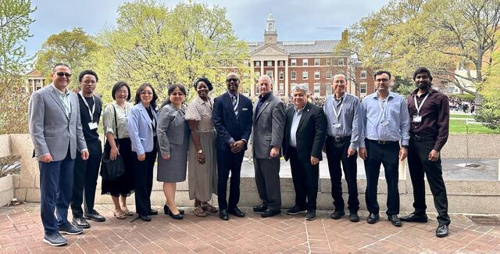
Project Team
PVAMU (lead):
  Cui; Zhai
CSU:
  Hadizabeh; Khan
AAMU:
  Xiao; Budak; Yuan; Yang; Zhao

Slide 3
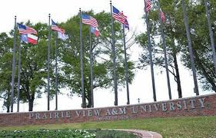
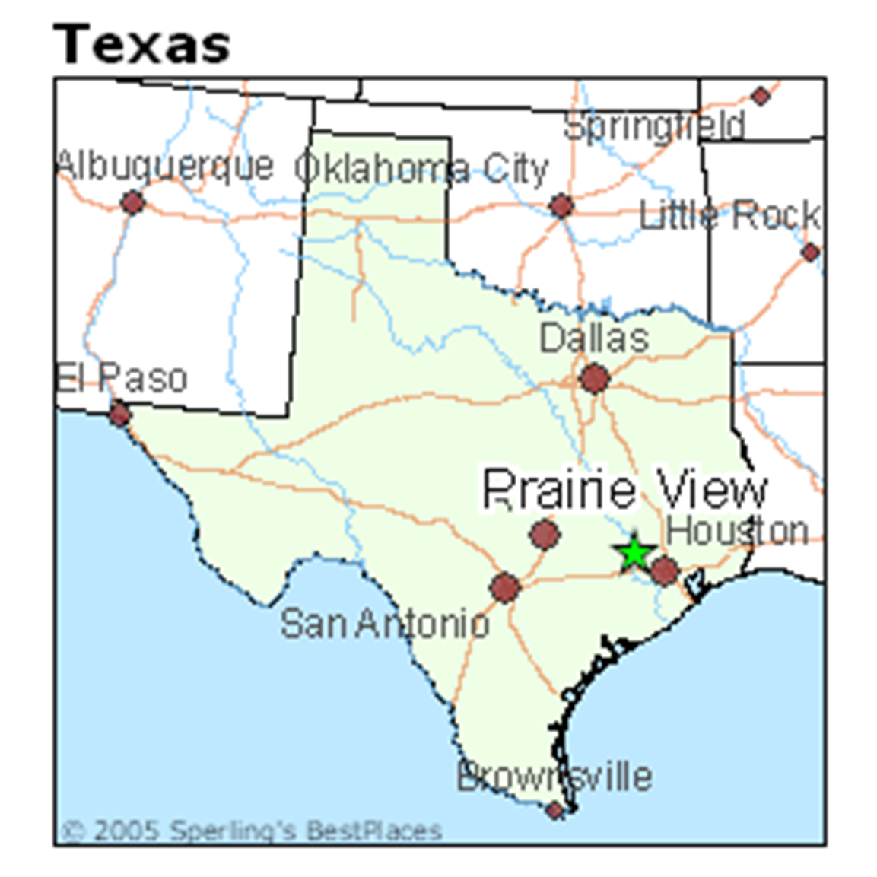
Prairie View A&M University
The second oldest public institution of higher learning in the State of Texas, founded in 1876
A rising research institution with R2 Carnegie Classification
ECE department offers BS, MS, and PhD degrees and contribute to our journey to R1
An ideal location for advancing semiconductor workforce development projects

Slide 4
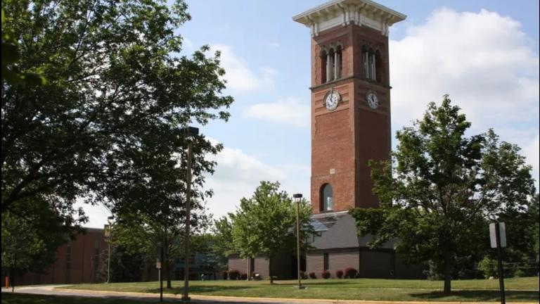
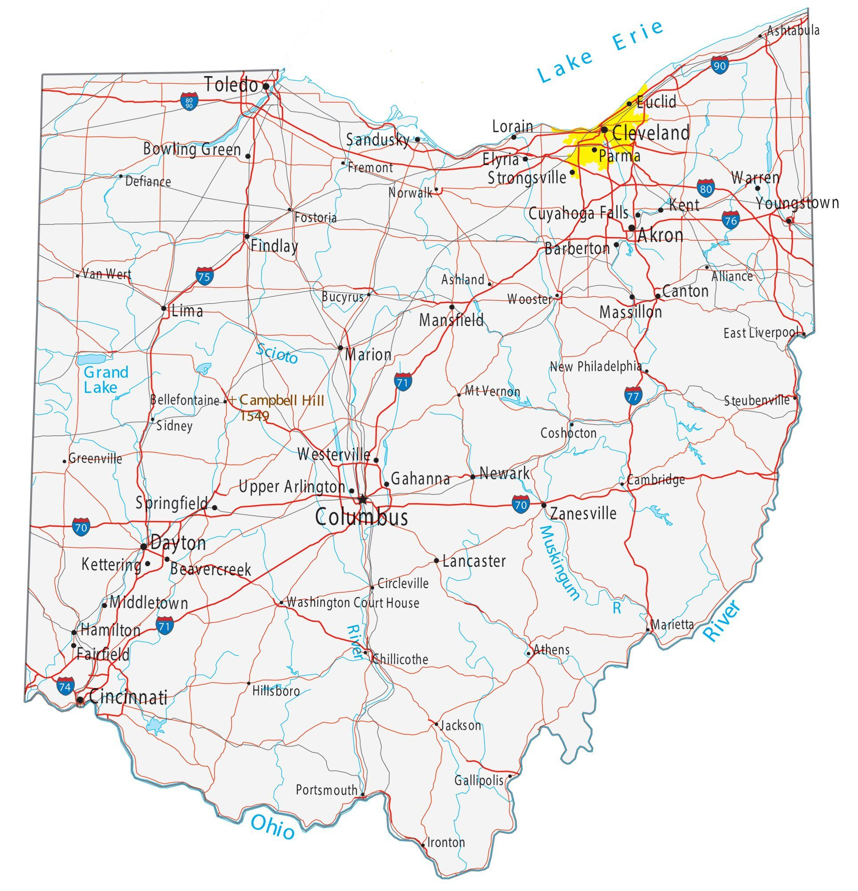
Central State University
The only state supported HBCU in Ohio, CSU has an enduring commitment to fostering leadership, facilitating groundbreaking research, and empowering its students to serve their communities.
CSU engages in numerous faculty-led research projects funded by prestigious organizations, including NASA, the NSF, the USDA, the DoD, etc.
Semiconductor Education and Research Program (SERP) was established in 2022 with three years of initial seed funding provided by Intel.
CSU’s Manufacturing Engineering and Environmental Engineering programs have been recognized for their excellence.

Slide 5

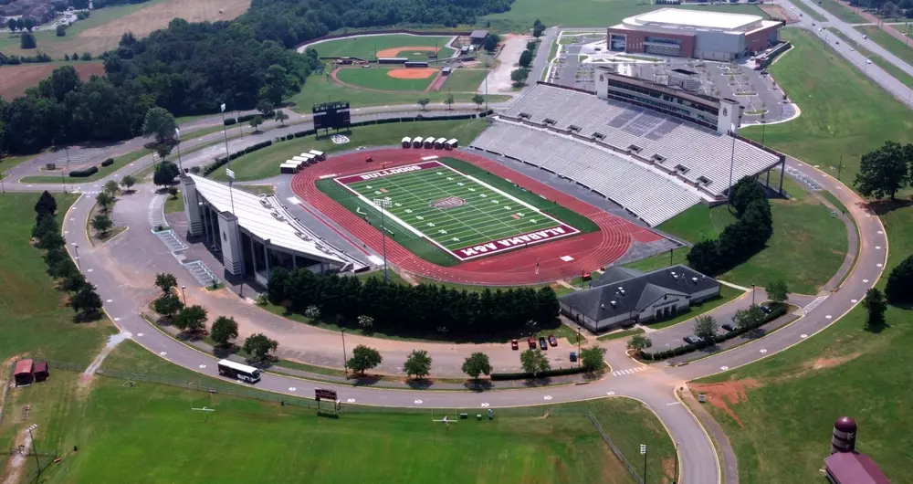
Alabama A&M University
Founded in 1876, AAMU has a long tradition of providing education in science, engineering, agriculture, and applied research that serves regional and national needs.
The university also collaborates with government, industry, and academic partners to advance research and economic development.
With roughly 500 undergraduate and more than 50 graduate students, the EECS Department is one of the largest academic
units at AAMU.
The BSEE Program has four concentrations: General Electrical Engineering,
Computer Engineering, Microelectronics/VLSI, and Nuclear Power.

Slide 6
Project Goal and Activities
Goal: Establish a consortium through ASEED to address the challenges of semiconductor workforce shortage.
Two-year project with a total of $1M
Activities:
  Research: Conduct and share our research through virtual seminars
  Education: Provide training opportunities
  Outreach: Engage high schools, community colleges and peer HBCUs

Slide 7
Research
Three research thrusts, each aligned with the expertise of our partner institutions:
  CSU: Thrust A - Advanced Exploration of 2D Semiconductor Materials through Computational and Experimental Methods
  PVAMU: Thrust B – Mixed-signal/AI Chip Design
  AAMU: Thrust C - Development of GaNBased Ultra-Wide Band Gap (UWBG) Semiconductor Devices and Electronic Chips for the Application of High-Frequency and High-Power Switching and Efficient Power Conversions

Slide 8
Topics in Seminar Series
Quantum Few-Body Systems in Two Dimensions
Additive manufacturing of glass microfiber reinforced polymer composites using vat polymerization
VLSI Chip Design and Fabrication for Solar Panel Diagnosis System
Design and Implementation of Hardware Accelerators
Hardware Implementation of Image Restoration
Successive Approximation Register Analog-to-Digital Converter Design
Ultra-Wide Band Gap (UWBG) Semiconductor Materials and Devices
Nanostructured Thin-Film Thermoelectric Materials and Devices
Big Data Analytics for Digital Twinning in Semiconductor Manufacturing
Design, simulation, and test of microwave subsystems
VLSI Design and IC Fabrication

Slide 9
Education
CSU: Undergraduate certificate and micro-credentials developed with industry partner (Intel)
PVAMU: Graduate certificate
AAMU: Concentration and minor
Our collaboration aims at:
  Share knowledge and expand workforce development opportunities
  Enable students to receive more training in semiconductor techniques

Slide 10
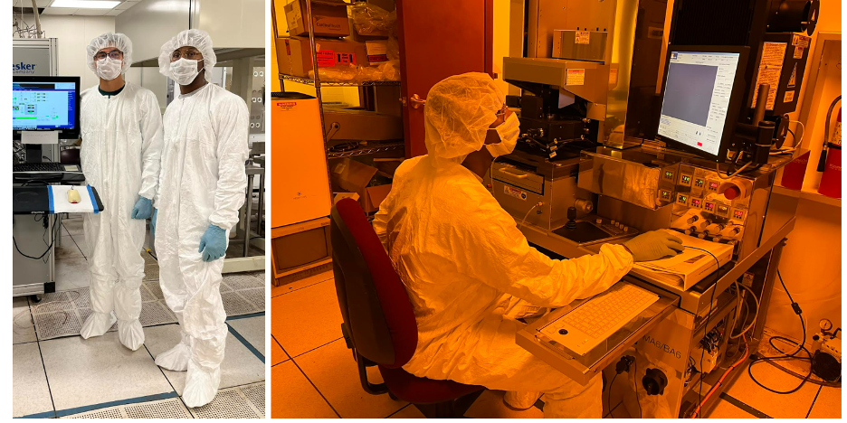
AAMU Students in the Clean Room
A sequence of Microelectronics/VLSI and Computer Engineering courses were updated in the Fall of 2024 and Spring of 2025.
New equipment funded by DoD grant to equip clean room to support the research and education

Slide 11
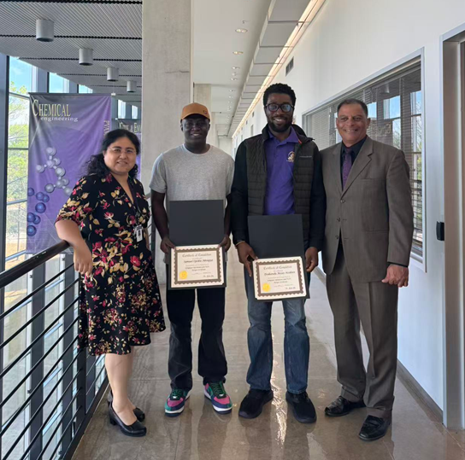
PVAMU Graduate Certificate
Computer Hardware and VLSI Design
Course Prefix and Number | Course Title | SCH
Required courses (9 credit hours)
ELEG 6342 | VLSI and ULSI Design | 3
ELEG 6341 | Advanced FPGA Design and Applications | 3
ELEG 6310 | Advanced Computer Systems Design | 3
Elective courses (9 credit hours)
ELEG6343 | Advanced VLSI Design Test and Characterization | 3
ELEG6314 | Fault Tolerant Computing | 3
ELEG6329 | Hardware Security | 3
ELEG 6351 | Advanced Quantum Devices | 3
ELEG6354 | Advanced Solid State | 3
ELEG 6365 | Intro to High Performance Computing | 3
ELEG 6311 | Computer Architecture & Advanced Logic Design | 3

Slide 12
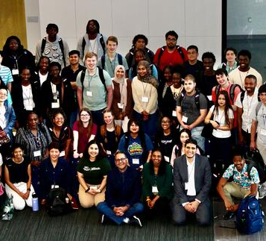
CSU Intel Semiconductor Education and Research Program
Started in 2022 with initial seed funding by Intel
Over the past 3 summers, the internships have trained 105 students across different training sites in Ohio, New York, Michigan, and Texas. We plan to train 40 students in the summer of 2026.
Paid eight week summer internship
Multiple peer institutions have joined the program
  Wright State University
  University of Michigan
  Prairie View A&M University
  North Carolina A&T University

Slide 13
PVAMU & CSU Summer Pilot Program
Week 1: Orientation + 5G Broadband Workshop
Week 2: STEM Summer Camp Mentorship
Week 3: Intensive Research Training
Week 4: Professional Development
Week 5: Semiconductor Micro-Credentials
Week 6: AI Training (Python)
Weeks 7–8: Research Project Completion & Presentations

Slide 14
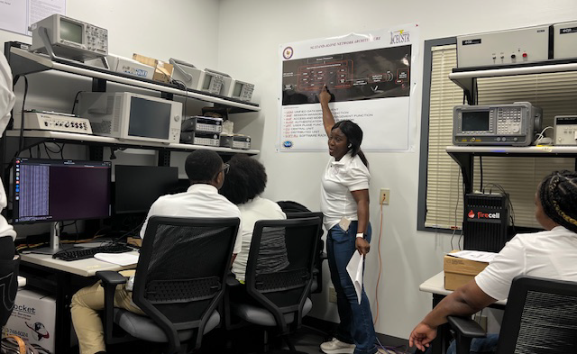
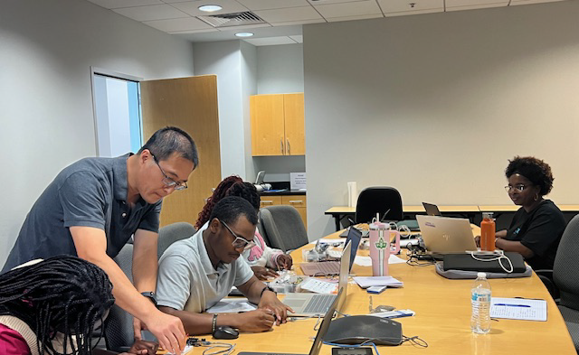
Technical Workshop Training
Students participated in multiple half day training modules:
  5G broadband communication
  Microcontroller / Arduino training
  Artificial intelligence modules
  Professional development
Training supported by research laboratories and centers at PVAMU.

Slide 15
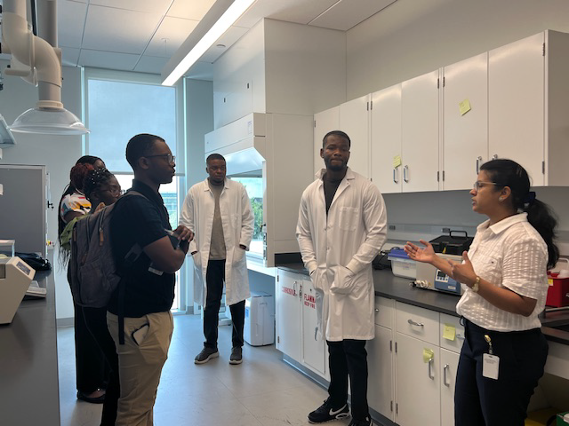
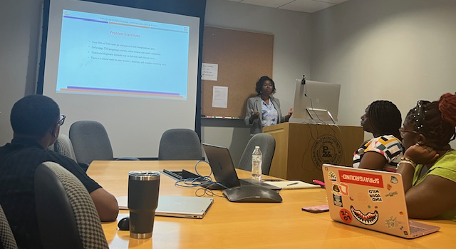
Research Mentorship
Students received mentorship from faculty, staff, and graduate students.
  Enhancing Gel Polymer Electrolytes for Li ion batteries through Ionic Liquid Integration and Nanostucturing (Dr. Nabila Shamim, associate professor of Chemical Engineering Department)
  Evaluating State-of-the-Art Object Detection Models for Auto-Vision: Traffic Analysis (Dr. Lujun Zhai, Research Assistant Professor of Electrical & Computer Engineering Department)
  Early-Stage Diabetes Risk Prediction Using Supervised Machine Learning Algorithms (Ms. Elizabeth M. Dada, PhD student of Electrical & Computer Engineering Department)

Slide 16
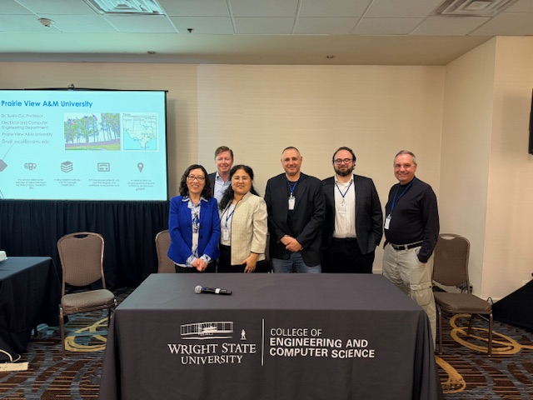
Outreach
Engage partners: Aiming at establishing future collaborative workforce development center
Co-author at ASEE Annual and ASE-GSW conferences
Co-presentation at the 2nd SaTC workshop
Support HBCU Chips Annual Workshops

Slide 17

Q & A
Contact:
Suxia Cui
Email: sucui@pvamu.edu

