Slide 1



Bridging the Talent Gap 2026
Accelerating Workforce Solutions for Semiconductors
HBCU CHIPS Conference | Atlanta, Georgia

Slide 2





Michelle Williams
Executive Director
mwilliams@semi.org

Slide 3


Every innovation begins with a chip: AI, EVs, clean energy, medicine, space, etc.

Slide 4




People Power Progress.
Innovation isn’t possible without people.
Skilled. Inspired.
The demand for semiconductor talent has never been greater. More than 170,000 new workers will be needed in the U.S. in the next five years.

Slide 5











Building the Workforce that Powers Our World
Mission: To support economic opportunity for workers and the sustained growth of the microelectronics industry through creating pathways and opportunities for job seekers, and tools and systems for semiconductor companies to attract, develop, retain, and advance a broad, skilled workforce.
50+ workforce initiatives worldwide in SEMI regions
Extensive national programming in the United States
Building opportunity at the regional and state level
Ensuring a skilled
talent pipeline
for industry
Founded in 2001. Global Impact Today.

Slide 6























Chips + Childcare
DOL Sponsorship
University Programs
Chips in Motion
Semiconductor Pride
VetWorks
Global Schools
SEMI Stories
Women of the FOA
High Tech U
SEMI U
Women in Semiconductors
NNME
Semiconductor Day
Chip In Doc
SCAN Arizona
SEMIquest
Certification Programming
SCAN California
Teacher Training
WFD Pavilion

Slide 7






5 Pillars Powering Our Programs and Initiatives
Early Awareness & Industry Exposure
Inspiring the next generation by making semiconductors real, relevant, and exciting.
Pathways
to Careers
Turning curiosity into careers with clear, industry-aligned training and opportunities.
Expanding
Opportunity & Access
Breaking barriers so everyone has a fair shot at success in semiconductors.
Global Workforce Solutions
Driving a worldwide movement to grow the semiconductor workforce.
National Talent Ecosystem for Scale
Unifying education, workforce, government and industry into a nationwide engine for talent.

Slide 8





Conversion from Awareness to Workforce Participation
Our Unique Approach to Move Beyond Awareness
AWARENESS (Spark)
↓
CURIOSITY (Why it matters to me)
↓
INTEREST (I want to try this)
↓
EXPLORATION (I’m doing something with it)
↓
PATHWAY EXPOSURE (I see where this can lead)
↓
COMMITMENT (I’ve chosen a route)
↓
PARTICIPATION (I’m learning, interning, or working)
↓
WORKFORCE ENTRY

Slide 9


National Network for Microelectronics Education (NNME)
2026

Slide 10


A National Response to the Workforce Challenge in​ Microelectronics
America’s economic competitiveness and national security depend on a strong, highly skilled semiconductor workforce. The U.S. will need more than 170,000 additional workers by 2030—making workforce development a national imperative. In response, the CHIPS & Science Act, with leadership from the National Science Foundation (NSF) and the Department of Commerce, has mobilized historic investments to secure the nation’s future.
Through this investment, the National Network for Microelectronics Education (NNME) was created.

Slide 11











America’s Gold Standard for Employer-Aligned Microelectronics Curriculum and Training
The NNME’s mission is clear: equip all Americans with employer-aligned curriculum and hands-on learning that lead to microelectronics careers—advancing U.S. innovation, competitiveness, and prosperity. Our vision is a unified, adaptable national talent ecosystem where education, industry, and opportunity move in lockstep to meet the evolving needs of the semiconductor sector.
Significance of the
Unifies fragmented
training & curricula
Creates a national
standard for
excellence
Expands access
for students and
workers
Ensures a skilled
talent pipeline
for industry

Slide 12

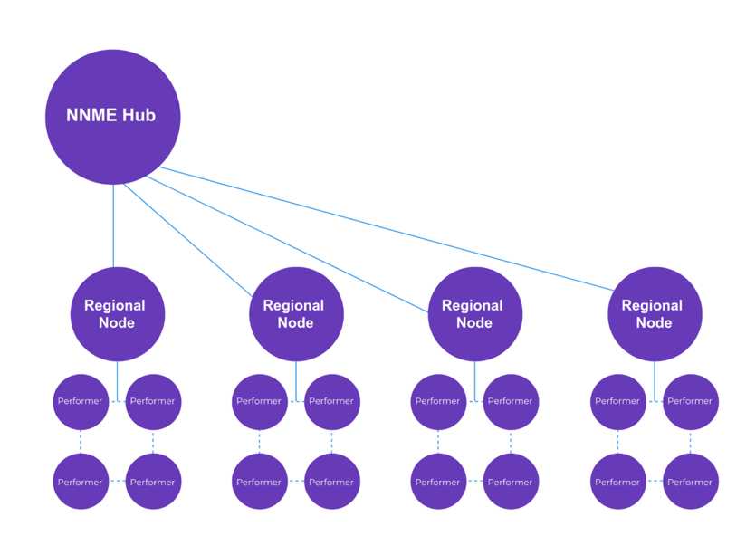
Connecting National Strategy to Regional Action
The U.S. faces a projected need for 170,000 additional semiconductor workers by 2030, but scaling the talent pipeline is constrained by systemic challenges. These include misalignment between education and industry needs, inequitable access to resources, chronic underinvestment in education and training activities and facilities, outdated workforce development capabilities, fragmented training ecosystems, and limited awareness of semiconductor career opportunities.
Regional Nodes change this.
Regional Nodes will serve as coordinating hubs that align regional stakeholders to develop and deliver industry-aligned education and training, expand equitable access, and strengthen pathways into high-demand semiconductor careers. Nodes will modernize and upgrade education and training activities and facilities, integrate emerging technologies, connect education providers with employers, scale work-based learning, build regional and community awareness, and align federal, state, and industry initiatives as part of a nationally coordinated strategy led by the NNME Hub.
Performers may include industry, colleges and universities, workforce development organizations, K-12 Schools, EDO's, etc.

Slide 13


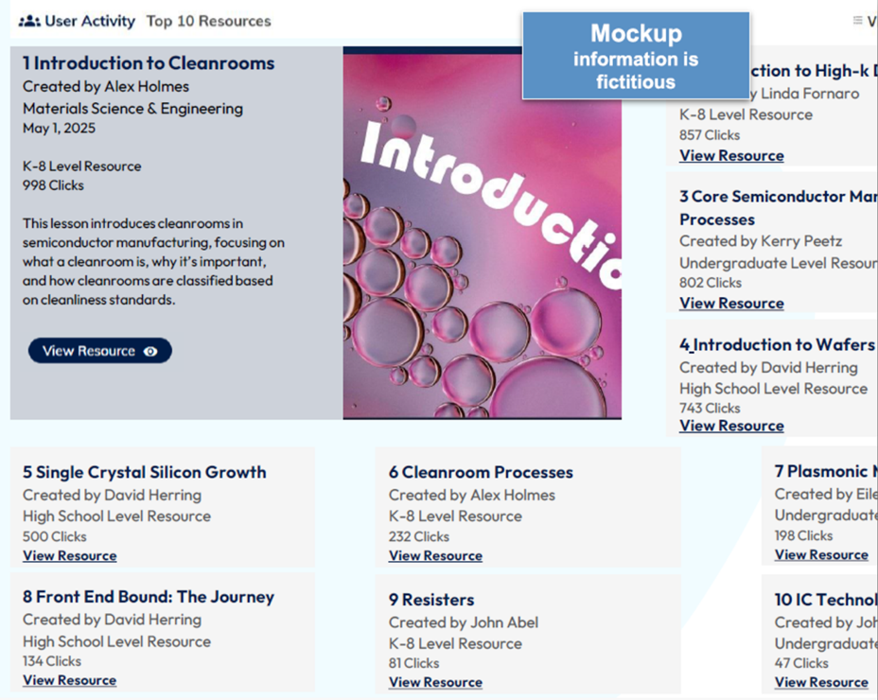

Status: In Progress
SemiSphere™ will transform semiconductor training with fresh, industry-aligned content designed to keep pace with rapid technological change. The platform will empower educators with modern modules and clear pathways that reflect real workforce needs.
SemiSphere™ will serve as the national first-stop portal where K–12 teachers, community colleges, and universities can access high-quality resources, exchange proven approaches to curriculum design, instruction, and assessment, and connect directly with the broader microelectronics ecosystem.

Slide 14


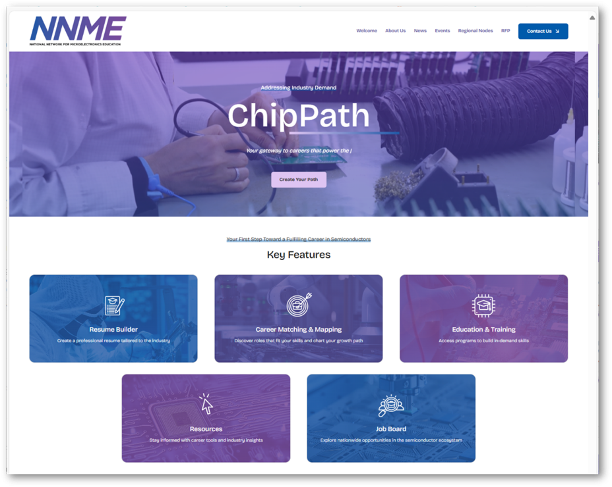

Status: Launched
ChipPath™ is the NNME’s new AI-enabled career platform and the central gateway into U.S. semiconductor careers. With over 130,000 live job openings sourced directly from SEMI member companies' career sites, it offers one of the most comprehensive views of opportunities across the microelectronics supply chain.
ChipPath™ offers AI-driven tools for career exploration, resume building, and training pathways—connecting talent to real opportunities and supporting entry into high-demand semiconductor roles.

Slide 15


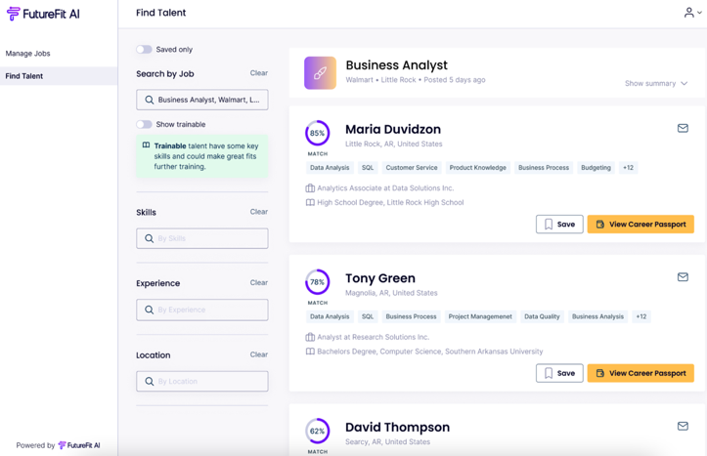


Coming in 2026: Employer Portal
Seamlessly Upload Jobs
Recruiters can post jobs or have jobs scraped in directly, with tools and automations to help them save time
Automated Candidate Matching
Get matched with candidates based on skills-based AI technology and reduce time to hire
Subtitle
Access Untapped Talent
Body Text
Identify “trainable” candidates to fill talent gaps with early-career talent and those with transferable skills

Slide 16

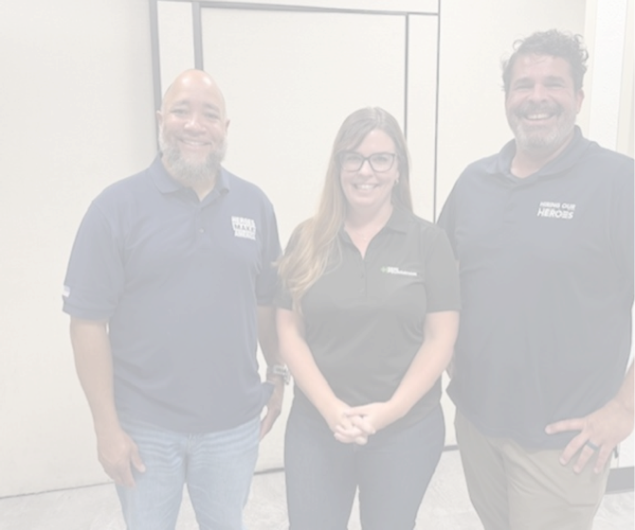






VetWorks
    55,000+ veterans and service members reached in 2025 through partnerships with DOL VETS, Hiring Our Heroes, and Heroes MAKE America.
    Recognized as a high-growth industry for transitioning military, with direct links to SEMI career pathways in official transition handbooks.
    30+ partner engagement events and 20+ employer participants this year, deepening industry connections.
    2025 focus: strengthening strategic partnerships to convert awareness into career opportunities for veterans nationwide.

Slide 17







Immersive Semiconductor Experience
Interactive Exhibit at the Arizona Science Center
47,300+ visitors and counting — including 160+ teachers and nearly 1,000 students, inspiring educators who reach 45,000+ learners statewide.
    Earned major visibility through local Arizona coverage and international media in Asia and India.
    Laying the groundwork to sustain and scale SEMIquest across Arizona and new communities nationwide.

Slide 18


SEMI Certificates
Progress
    45 companies, 16 states engaged to define competencies.
    SMEs from 12 colleges/universities developing assessments.
    Pilot underway:
      46 participants completed multiple-choice (Part One) pilot.
      Hands-on pilot (Part Two) launched in March.
Next Steps
    Validate pilot data and finalize assessments.
    Launch regionally in Spring 2026, with a measured 30/60/90-day review cycle.
    Continue partnering with employers to integrate certification into hiring.
Call to Action
    Nominate new hires or grads to join the pilot.
    Champion SEMI Certificates in your company’s hiring practices.

Slide 19


Through this model, the Foundation will:
    Reduce administrative and regulatory barriers by serving as the single point of contact with USDOL and managing registration, reporting, and compliance on behalf of members.
    Standardize high-quality, industry-aligned frameworks that reflect real semiconductor roles and skills while remaining adaptable to employer-specific needs.
    Enable faster deployment across states and regions through nationally approved standards that can be implemented without rebuilding programs state-by-state.
    Ensure federal quality standards without limiting employer control by maintaining compliance, reporting and oversight while employers retain authority over hiring, training, and workforce outcomes.
SEMI F Named USDoL National Group Sponsor for Registered Apprenticeships
The SEMI Foundation can now design, register, and scale apprenticeships nationally, working directly with member companies, removing friction and accelerating adoption

Slide 20






Partner on Workforce Programs
Shape talent pipelines through internships, apprenticeships, and curriculum alignment.
Join Our Networks
Collaborate with peers and share best practices
Sponsor Awareness + Education Initiatives
From Chips in Motion to SEMIquest and Student Tours—make semiconductors visible and exciting.
Support Access Programs
Champion initiatives like Women in Semiconductors, VetWorks
Invest in the Future
Support scholarships, program expansion, and national efforts like the NNME to sustain long-term growth.
Powering Progress Together.
Ways to get involved

Slide 21


The workforce challenge is the opportunity of our time. Let's collaborate!
Michelle Williams
Executive Director, SEMI Foundation
mwilliams@semi.org

